Slide 1
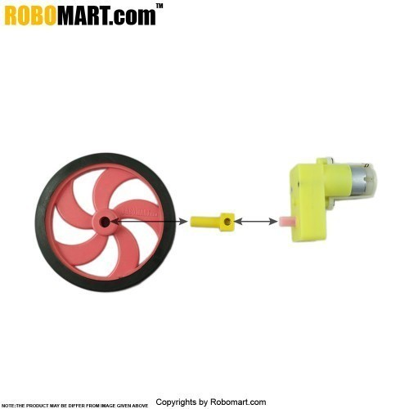
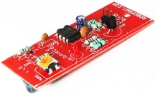
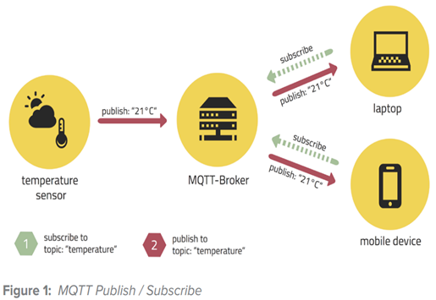
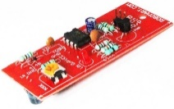
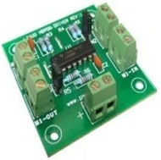
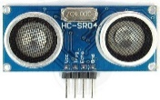
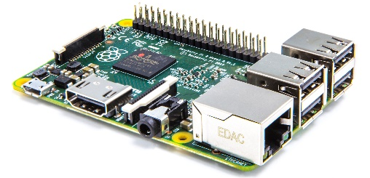

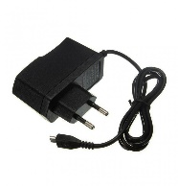
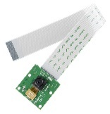
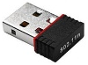
No. | Item
1 | Raspberry Pi 2
2 | Wifi Dongle
3 | Raspberry Pi Camera
4 | 5V Adapter
5 | Ultrasonic Sensor
6 | IR Sensors
7 | Left Side DC Motor
8 | Right Side DC Motor
9 | L293D Motor Driver Board
10 | 9V Battery
7
8
6
Publish
9
Subscribe
5
Publish
Publish
10
1
Subscribe
4
3
2

Slide 2


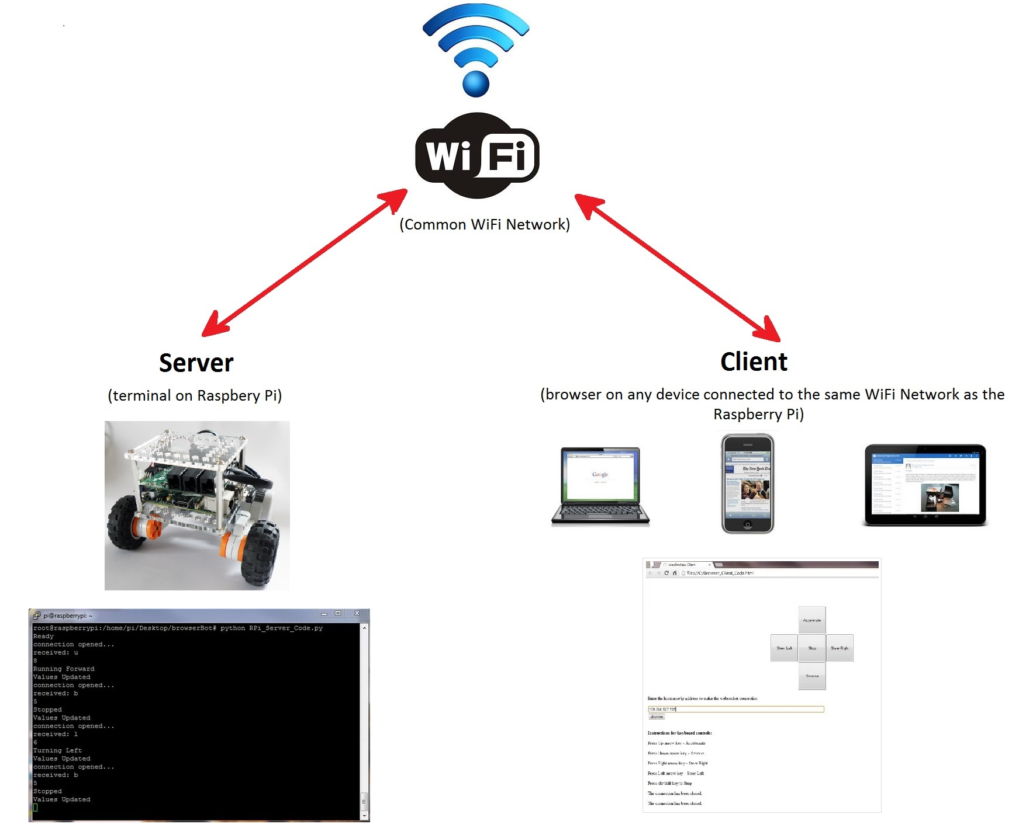
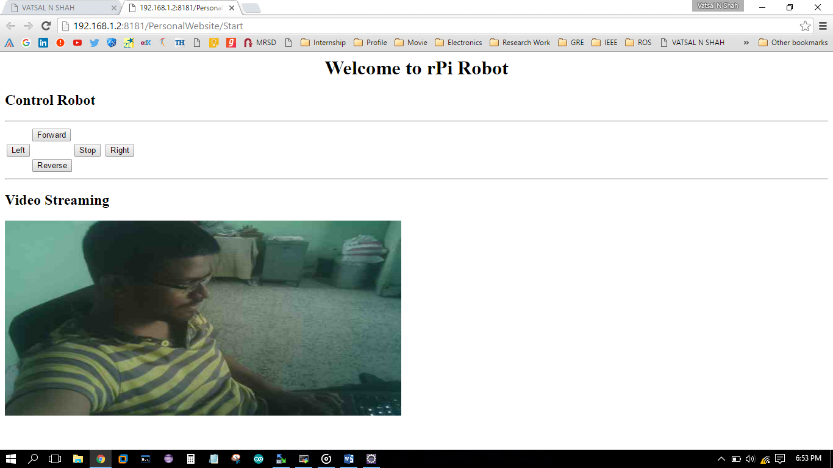
Common WiFi Network
Server
(Raspberry Pi)
Client
(browser on any device connected to the same WiFi network as the Raspberry Pi)
7
8
6
9
5
10
4
1
3
2

Slide 3
7
8
6
Publish
9
Publish
Subscribe
5
Publish
10
1
Subscribe
4
3
2

